Slide 1





English
English
Course Introduction
Course Introduction

Slide 2
Content
Course description in brief
Course Features
Course plan, Unit plan, Unit test
Examination and Evaluation strategy
Student Resource Disk
CMS – the Internet Learning Portal
How to be successful with Top Notch/Summit in FPT University

Slide 3
6 Levels
Level 1: Top Notch Fundamentals – ENT103
Level 2: Top Notch 1 – ENT104
Level 3: Top Notch 2 – ENT203
Level 4: Top Notch 3 – ENT303
Level 5: Summit 1 – ENT403
Level 6: Summit 2 – ENT503

Slide 4
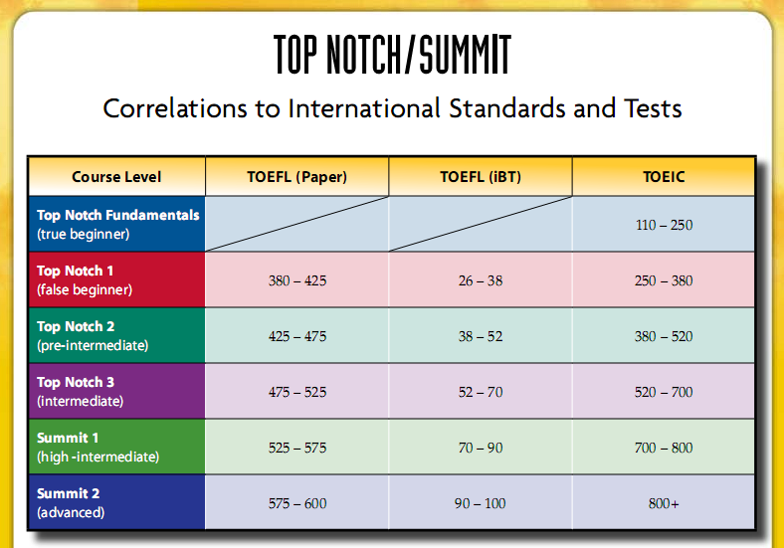
Correlations to International Standards and Tests
http://www.pearsonlongman.com/ae/topnotch/correlations/TN_Summit_corrs_intltests.pdf

Slide 5
Description
Dynamic course for international communication
Focuses on the natural language that people really speak
Provides students with an opportunity to confirm their own progress at the end of every easy-to-learn lesson

Slide 6
Key features
Essential model conversations that make key social language unforgettable and easy to personalize
"Top Notch Interactions" is a unique step-by-step discussion builder that guarantees success
Super CD containing both self-study audio and interactive exercises motivates students after class

Slide 7
Other Distinguishing Features
Concise two-page integrated skills lessons, each designed for one class session
Clear communication goals for every lesson
Confirmation of student’s progress at the end of each class session
Practical content designed for the real communicative needs of today’s student
An unparalleled array of supplementary materials to provide the flexibility needed for any teaching situation

Slide 8
Course plan
Course duration: 140 periods
Unit 1
Unit 2
Unit 3
Unit 4
Unit 5
Unit 6
Unit 7
Unit 8
Unit 9
Unit 10
Final Examination
Notes:
3. The Top Notch Pop and Karaoke, with twenty original songs, professionally written and that reinforce vocabulary and grammar from the student’s book. (play an excerpt of the Top Notch Pop Song from the Class Audio Program or from the Top Notch Video and invite attendees to sing along)

Slide 9
Unit plan
7 slots, 2 periods per slot
Preview
Lesson 1
Lesson 2
Lesson 3
Lesson 4
Writing – Practice of writing sentences, paragraphs
Additional activities, TV
Review & Unit Test
}
Textbook, CD, workbook
Textbook, CD, workbook,
Teacher resource disk,
TV
Notes:
3. The Top Notch Pop and Karaoke, with twenty original songs, professionally written and that reinforce vocabulary and grammar from the student’s book. (play an excerpt of the Top Notch Pop Song from the Class Audio Program or from the Top Notch Video and invite attendees to sing along)

Slide 10
Course plan / Syllabus
See course plan / Syllabus on LMS
http://lms-undergrad.fpt.edu.vn

Slide 11
Final Exams
4 sections
  Listening skill
  Grammar, Vocabulary, Reading comprehension skills
  Writing skill
  Speaking skill
Final exam coverage: the full course
Important: at least 80% class attendance is required to take final examination

Slide 12
Evaluation Strategy
Participation (PA) 10%
Progress Tests (PT) 20%
Writing assignment 10%
Speaking assignment 10%
Final Examination score (FE) 50%
Final result: 50% on-going assessment + 50%FE = 100%
Completion criteria
Pass= Every on-going assessment component > 0, Final Result >= 5/10 and Final Exam >= 4/10
Each part of final exam must be >0.
1. If not meet a), students must retake all parts of the exam.
2. If meet a); but not b), students must retake the failed parts only.
On-going assessment

Slide 13
What’s in CD or on Intranet?
For each unit
  Audio tracks
  Unit resource – for lesson activities
  Activity Materials (copy and go) – for lesson consolidation, at the end of each lesson or in the additional activity session
  TV Activity worksheet
  Material for the TV session for unit consolidation
  Super CD - interactive exercises
  Workbook – the scanned copy
  Student are required to install or download these materials to the laptop and be ready for doing activities in classroom, follow teacher’s instruction

Slide 14
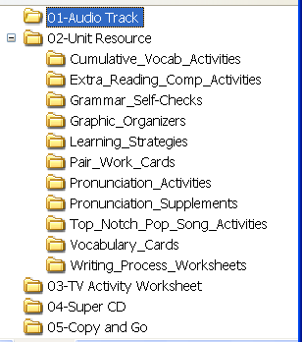
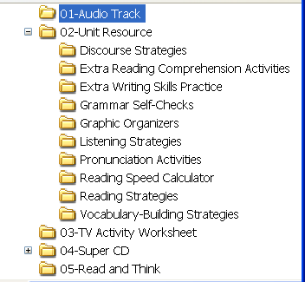
On Intranet

Slide 15
On Intranet
Audio track
Unit resource
  Extra reading
  Grammar
  Writing
  Pop song
  ...
TV Activity worksheet
Super CD
Copy and Go
Workbook

Slide 16
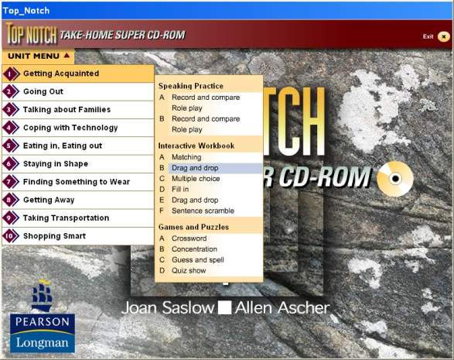
Super CD
Numerous interactive practices for each unit
Notes:
Run the CD

Slide 17





How to be successful with
Top Notch/Summit in
FPT University
How to be successful with
Top Notch/Summit in
FPT University

Slide 18
Student’s preparation
Prior to the course
  Laptop with appropriate software and learning resources (PDF reading and noting tool)
  Student’s book with CD
  Additional resource on FUHCM server
  Be familiar with online learning portal, companion website

Slide 19
Student’s preparation
Prior to the class sessions
  Complete all homework, assignments,
  Be familiar with the new lessons by the next class sessions,
  Get the laptop ready for use in class, be prepared with necessary learning resources
Make use of student’s book,
workbook,
CD, CMS,
companion website,
and additional materials

Slide 20
During the class sessions
  Be active learning
  Take all opportunities to practice English in Communication with the support of the teachers and the interaction of classmates
  Ask questions when unclear
  Give positive feedback when needed
  Be polite, and respectful in behavior
  Use the laptop only for learning activities and follow teacher’s instruction
  More rules .. according to University policy
  Carry books to class and may use pencil to note on student’s book

Slide 21
Guidelines to success
Be familiar with resources, software tools, CMS, companion website before the course
Be prepared for each classroom session
Be active and communicative in classroom
Do all homework on time,
do exercises/puzzles on the companion website
Make use of other materials
Take opportunities to practice English
Take your time to improve your accent

Slide 22
Top Notch/Summit
Makes English Unforgettable
Takes you to a
Successful Career

